Slide 1
Modeling and Solving LP Problems in a Spreadsheet
Lecture 8
Chapter 3: Optimization
Institute of Engineering
Asst. Prof. Anita Prajapati, Ph.D.
23 June 2023

Slide 2
Modeling and Solving LP Problems in a Spreadsheet
Chapter 3
Spreadsheet Modeling & Decision Analysis:
A Practical Introduction to Management Science
3d edition
by Cliff Ragsdale
3-<number>

Slide 3
Introduction
Solving LP problems graphically is only possible when there are two decision variables
Few real-world LP have only two decision variables
Fortunately, we can now use spreadsheets to solve LP problems
3-<number>

Slide 4
Spreadsheet Solvers
The company that makes the Solver in Excel, Lotus 1-2-3, and Quattro Pro is Frontline Systems, Inc.
  Check out their web site:
  http://www.frontsys.com
Other packages for solving MP problems:
  AMPL LINDO
  CPLEX MPSX
3-<number>

Slide 5
The Steps in Implementing LP Model in a Spreadsheet
Organize the data for the model on the spreadsheet.
Reserve separate cells in the spreadsheet to represent each decision variable in the model.
Create a formula in a cell in the spreadsheet that corresponds to the objective function.
4. For each constraint, create a formula in a separate cell in the spreadsheet that corresponds to the left-hand side (LHS) of the constraint.
3-<number>

Slide 6
Let’s Implement a Model for the
Blue Ridge Hot Tubs Example...
MAX: 350X₁ + 300X₂ } profit
S.T.: 1X₁ + 1X₂ <= 200 } pumps
9X₁ + 6X₂ <= 1566 } labor
12X₁ + 16X₂ <= 2880 } tubing
X₁, X₂ >= 0 } non-negativity
3-<number>

Slide 7
Implementing the Model
See file Fig3-1.xls
3-<number>

Slide 8
How Solver Views the Model
Target cell - the cell in the spreadsheet that represents the objective function
Changing cells - the cells in the spreadsheet representing the decision variables
Constraint cells - the cells in the spreadsheet representing the LHS formulas on the constraints
3-<number>

Slide 9
Let’s go back to Excel and see how Solver works...
3-<number>

Slide 10
Goals For Spreadsheet Design
Communication - A spreadsheet's primary business purpose is that of communicating information to managers.
Reliability - The output a spreadsheet generates should be correct and consistent.
Auditability - A manager should be able to retrace the steps followed to generate the different outputs from the model in order to understand the model and verify results.
Modifiability - A well-designed spreadsheet should be easy to change or enhance in order to meet dynamic user requirements.
3-<number>

Slide 11
Spreadsheet Design Guidelines
Organize the data, then build the model around the data.
Do not embed numeric constants in formulas.
Things which are logically related should be physically related.
Use formulas that can be copied.
Column/rows totals should be close to the columns/rows being totaled.
The English-reading eye scans left to right, top to bottom.
Use color, shading, borders and protection to distinguish changeable parameters from other model elements.
Use text boxes and cell notes to document various elements of the model.
3-<number>

Slide 12
Make vs. Buy Decisions:
The Electro-Poly Corporation
Electro-Poly is a leading maker of slip-rings.
A $750,000 order has just been received.
Model 1 Model 2 Model 3
Number ordered 3,000 2,000 900
Hours of wiring/unit 2 1.5 3
Hours of harnessing/unit 1 2 1
Cost to Make $50 $83 $130
Cost to Buy $61 $97 $145
The company has 10,000 hours of wiring capacity and 5,000 hours of harnessing capacity.
3-<number>

Slide 13
Defining the Decision Variables
M₁ = Number of model 1 slip rings to make in-house
M₂ = Number of model 2 slip rings to make in-house
M₃ = Number of model 3 slip rings to make in-house
B₁ = Number of model 1 slip rings to buy from competitor
B₂ = Number of model 2 slip rings to buy from competitor
B₃ = Number of model 3 slip rings to buy from competitor
3-<number>

Slide 14
Defining the Objective Function
Minimize the total cost of filling the order.
MIN: 50M₁ + 83M₂ + 130M₃ + 61B₁ + 97B₂ + 145B₃
3-<number>

Slide 15
Defining the Constraints
Demand Constraints
  M₁ + B₁ = 3,000 } model 1
  M₂ + B₂ = 2,000 } model 2
  M₃ + B₃ = 900 } model 3
Resource Constraints
  2M₁ + 1.5M₂ + 3M₃ <= 10,000 } wiring
  1M₁ + 2.0M₂ + 1M₃ <= 5,000 } harnessing
Non-negativity Conditions
  M₁, M₂, M₃, B₁, B₂, B₃ >= 0
3-<number>

Slide 16
Implementing the Model
See file Fig3-17.xls
3-<number>

Slide 17
An Investment Problem:
Retirement Planning Services, Inc.
A client wishes to invest $750,000 in the following bonds.
Years to
Company Return Maturity Rating
Acme Chemical 8.65% 11 1-Excellent
DynaStar 9.50% 10 3-Good
Eagle Vision 10.00% 6 4-Fair
Micro Modeling 8.75% 10 1-Excellent
OptiPro 9.25% 7 3-Good
Sabre Systems 9.00% 13 2-Very Good
3-<number>

Slide 18
Investment Restrictions
No more than 25% can be invested in any single company.
At least 50% should be invested in long-term bonds (maturing in 10+ years).
No more than 35% can be invested in DynaStar, Eagle Vision, and OptiPro.
3-<number>

Slide 19
Defining the Decision Variables
X₁ = amount of money to invest in Acme Chemical
X₂ = amount of money to invest in DynaStar
X₃ = amount of money to invest in Eagle Vision
X₄ = amount of money to invest in MicroModeling
X₅ = amount of money to invest in OptiPro
X₆ = amount of money to invest in Sabre Systems
3-<number>

Slide 20
Defining the Objective Function
Maximize the total annual investment return.
MAX: .0865X₁ + .095X₂ + .10X₃ + .0875X₄ + .0925X₅ + .09X₆
3-<number>

Slide 21
Defining the Constraints
Total amount is invested
  X₁ + X₂ + X₃ + X₄ + X₅ + X₆ = 750,000
No more than 25% in any one investment
  X_{i} <= 187,500, for all i
50% long term investment restriction.
  X₁ + X₂ + X₄ + X₆ >= 375,000
35% Restriction on DynaStar, Eagle Vision, and OptiPro.
  X₂ + X₃ + X₅ <= 262,500
Non-negativity conditions
  X_{i} >= 0 for all i
3-<number>

Slide 22
Implementing the Model
See file Fig3-20.xls
3-<number>

Slide 23
A scheduling problem: Air-Express
Anyone responsible for creating work schedules for a number of employees can appreciate the difficulties in this task. It can be very difficult to develop a feasible schedule, much less than an optimal schedule.
LP models have been devised to solve these problems.
3-<number>

Slide 24
A scheduling problem: Air-Express
Air-Express is an express shipping service that guarantees overnight delivery of packages anywhere in the continental United states. The Co. has various operations centers, called hubs, at airports in major cities across the country. Packages are received at hubs from other locations and then shipped to intermediate hubs or to their final destinations.
3-<number>

Slide 25
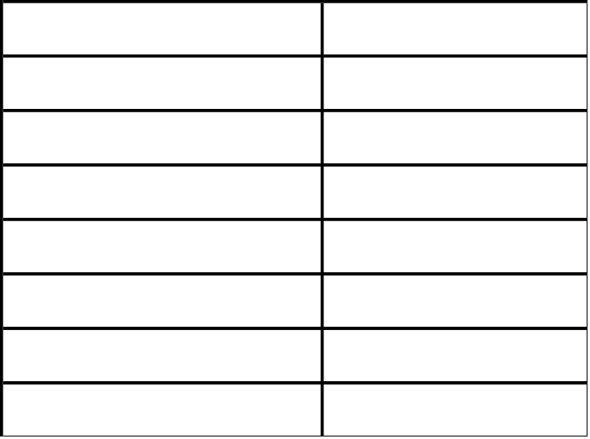
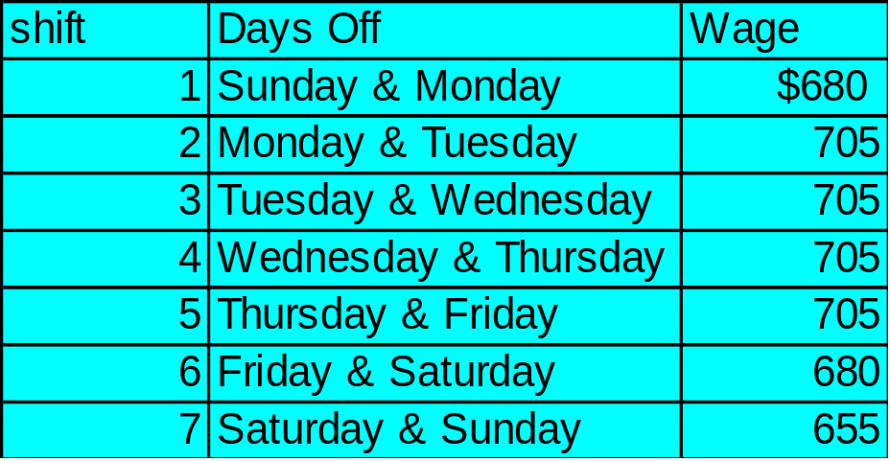
A scheduling problem: Air-Express
As per negotiation, Saturday and Sunday are off days and the Co. has to pay extra $ 25 per day for workers on their work on these days.
3-<number>

Slide 26
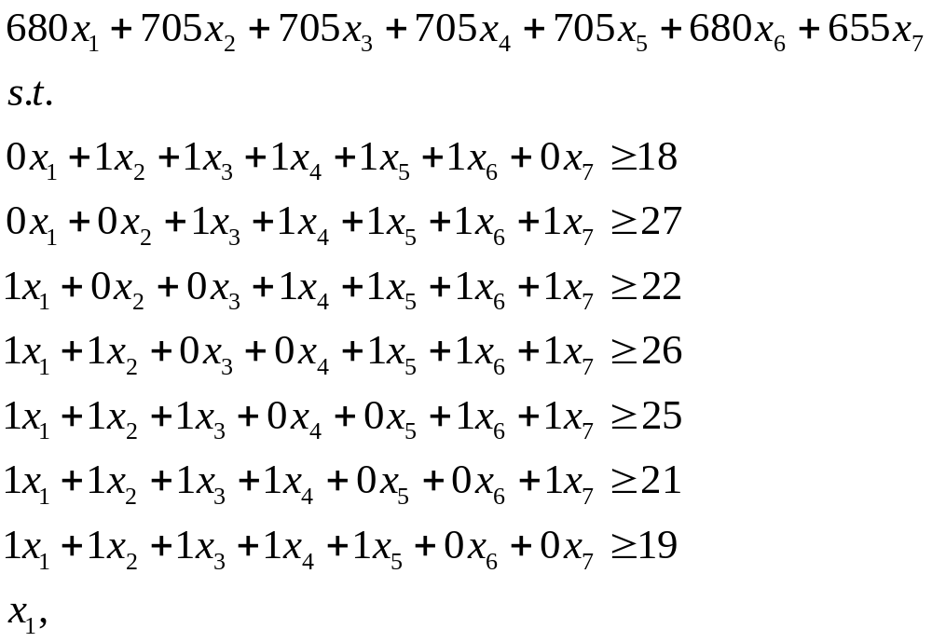

A scheduling problem: Air-Express
Model
Min:
3-<number>

Slide 27
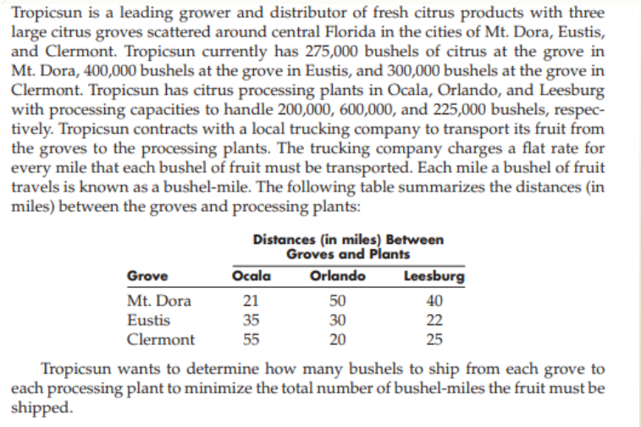
Transportation & Assignment Problems
5-<number>

Slide 28
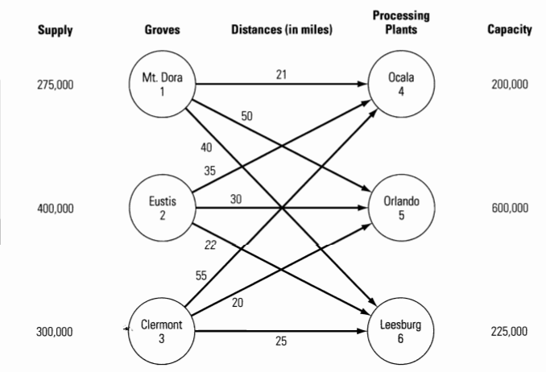
A Transportation Problem:
Tropicsun
3-<number>

Slide 29
Defining the Decision Variables
X_{ij} = # of bushels shipped from node i to node j
Specifically, the nine decision variables are:
X₁₄ = # of bushels shipped from Mt. Dora (node 1) to Ocala (node 4)
X₁₅ = # of bushels shipped from Mt. Dora (node 1) to Orlando (node 5)
X₁₆ = # of bushels shipped from Mt. Dora (node 1) to Leesburg (node 6) X₂₄ = # of bushels shipped from Eustis (node 2) to Ocala (node 4)
X₂₅ = # of bushels shipped from Eustis (node 2) to Orlando (node 5)
X₂₆ = # of bushels shipped from Eustis (node 2) to Leesburg (node 6)
X₃₄ = # of bushels shipped from Clermont (node 3) to Ocala (node 4)
X₃₅ = # of bushels shipped from Clermont (node 3) to Orlando (node 5)
X₃₆ = # of bushels shipped from Clermont (node 3) to Leesburg (node 6)
3-<number>

Slide 30
Defining the Objective Function
Minimize the total number of bushel-miles.
MIN: 21X₁₄ + 50X₁₅ + 40X₁₆ +
35X₂₄ + 30X₂₅ + 22X₂₆ +
55X₃₄ + 20X₃₅ + 25X₃₆
3-<number>

Slide 31
Defining the Constraints
Capacity constraints
  X₁₄ + X₂₄ + X₃₄ <= 200,000 } Ocala
  X₁₅ + X₂₅ + X₃₅ <= 600,000 } Orlando
  X₁₆ + X₂₆ + X₃₆ <= 225,000 } Leesburg
Supply constraints
  X₁₄ + X₁₅ + X₁₆ = 275,000 } Mt. Dora
  X₂₄ + X₂₅ + X₂₆ = 400,000 } Eustis
  X₃₄ + X₃₅ + X₃₆ = 300,000 } Clermont
Nonnegativity conditions
  X_{ij} >= 0 for all i and j
3-<number>

Slide 32
Implementing the Model
See file Fig3-24.xls
3-<number>

Slide 33
A Blending Problem:
The Agri-Pro Company
Agri-Pro has received an order for 8,000 pounds of chicken feed to be mixed from the following feeds.
Percent of Nutrient in
Nutrient Feed 1 Feed 2 Feed 3 Feed 4
Corn 30% 5% 20% 10%
Grain 10% 30% 15% 10%
Minerals 20% 20% 20% 30%
Cost per pound $0.25 $0.30 $0.32 $0.15
The order must contain at least 20% corn, 15% grain, and 15% minerals.
3-<number>

Slide 34
Defining the Decision Variables
X₁ = pounds of feed 1 to use in the mix
X₂ = pounds of feed 2 to use in the mix
X₃ = pounds of feed 3 to use in the mix
X₄ = pounds of feed 4 to use in the mix
3-<number>

Slide 35
Defining the Objective Function
Minimize the total cost of filling the order.
MIN: 0.25X₁ + 0.30X₂ + 0.32X₃ + 0.15X₄
3-<number>

Slide 36
Defining the Constraints
Produce 8,000 pounds of feed
  X₁ + X₂ + X₃ + X₄ = 8,000
Mix consists of at least 20% corn
  (0.3X₁ + 0.5X₂ + 0.2X₃ + 0.1X₄)/8000 >= 0.2
Mix consists of at least 15% grain
  (0.1X₁ + 0.3X₂ + 0.15X₃ + 0.1X₄)/8000 >= 0.15
Mix consists of at least 15% minerals
  (0.2X₁ + 0.2X₂ + 0.2X₃ + 0.3X₄)/8000 >= 0.15
Nonnegativity conditions
  X₁, X₂, X₃, X₄ >= 0
3-<number>

Slide 37
A Comment About Scaling
Notice that the coefficient for X₂ in the ‘corn’ constraint is 0.05/8000 = 0.00000625
As Solver solves our problem, intermediate calculations must be done that make coefficients large or smaller.
Storage problems may force the computer to use approximations of the actual numbers.
Such ‘scaling’ problems sometimes prevents Solver from being able to solve the problem accurately.
Most problems can be formulated in a way to minimize scaling errors...
3-<number>

Slide 38
Re-Defining the Decision Variables
X₁ = thousands of pounds of feed 1 to use in the mix
X₂ = thousands of pounds of feed 2 to use in the mix
X₃ = thousands of pounds of feed 3 to use in the mix
X₄ = thousands of pounds of feed 4 to use in the mix
3-<number>

Slide 39
Re-Defining the Objective Function
Minimize the total cost of filling the order.
MIN: 250X₁ + 300X₂ + 320X₃ + 150X₄
3-<number>

Slide 40
Re-Defining the Constraints
Produce 8,000 pounds of feed
  X₁ + X₂ + X₃ + X₄ = 8
Mix consists of at least 20% corn
  (0.3X₁ + 0.5X₂ + 0.2X₃ + 0.1X₄)/8 >= 0.2
Mix consists of at least 15% grain
  (0.1X₁ + 0.3X₂ + 0.15X₃ + 0.1X₄)/8 >= 0.15
Mix consists of at least 15% minerals
  (0.2X₁ + 0.2X₂ + 0.2X₃ + 0.3X₄)/8 >= 0.15
Nonnegativity conditions
  X₁, X₂, X₃, X₄ >= 0
3-<number>

Slide 41
A Comment About Scaling
Earlier the largest coefficient in the constraints was 8,000 and the smallest is 0.05/8 = 0.00000625.
Now the largest coefficient in the constraints is 8 and the smallest is 0.05/8 = 0.00625.
The problem is now more evenly scaled.
3-<number>

Slide 42
A Production Planning Problem:
The Upton Corporation
Upton is planning the production of their heavy-duty air compressors for the next 6 months.
Month
1 2 3 4 5 6
Unit Production Cost $240 $250 $265 $285 $280 $260
Units Demanded 1,000 4,500 6,000 5,500 3,500 4,000
Maximum Production 4,000 3,500 4,000 4,500 4,000 3,500
Minimum Production 2,000 1,750 2,000 2,250 2,000 1,750
Beginning inventory = 2,750 units
Safety stock = 1,500 units
Unit carrying cost = 1.5% of unit production cost
Maximum warehouse capacity = 6,000 units
3-<number>

Slide 43
Defining the Decision Variables
P_{i} = number of units to produce in month i, i=1 to 6
B_{i} = beginning inventory month i, i=1 to 6
3-<number>

Slide 44
Defining the Objective Function
Minimize the total cost production & inventory costs.
MIN: 240P₁+ 250P₂ + 265P₃ + 285P₄ + 280P₅ + 260P₆ + 3.6(B₁+B₂)/2 + 3.75(B₂+B₃)/2 + 3.98(B₃+B₄)/2 + 4.28(B₄+B₅)/2 + 4.20(B₅+ B₆)/2 + 3.9(B₆+B₇)/2
Note: The beginning inventory in any month is the same as the
ending inventory in the previous month.
3-<number>

Slide 45
Defining the Constraints
Production levels
2,000 <= P₁ <= 4,000 } month 1
1,750 <= P₂ <= 3,500 } month 2
2,000 <= P₃ <= 4,000 } month 3
2,250 <= P₄ <= 4,500 } month 4
2,000 <= P₅ <= 4,000 } month 5
1,750 <= P₆ <= 3,500 } month 6
Ending Inventory (EI = BI + P - D)
1,500 <= B₁ + P₁ - 1,000 <= 6,000 } month 1
1,500 <= B₂ + P₂ - 4,500 <= 6,000 } month 2
1,500 <= B₃ + P₃ - 6,000 <= 6,000 } month 3
1,500 <= B₄ + P₄ - 5,500 <= 6,000 } month 4
1,500 <= B₅ + P₅ - 3,500 <= 6,000 } month 5
1,500 <= B₆ + P₆ - 4,000 <= 6,000 } month 6
3-<number>

Slide 46
Defining the Constraints (cont’d)
Beginning Balances
B₁ = 2750
B₂ = B₁ + P₁ - 1,000
B₃ = B₂ + P₂ - 4,500
B₄ = B₃ + P₃ - 6,000
B₅ = B₄ + P₄ - 5,500
B₆ = B₅ + P₅ - 3,500
B₇ = B₆ + P₆ - 4,000
Notice that the B_{i} can be computed directly from the P_{i}. Therefore, only the P_{i} need to be identified as changing cells.
3-<number>

Slide 47
Implementing the Model
See file Fig3-31.xls
3-<number>

Slide 48
Assignment
Question Number : 14,15, 18,21,22,24, 25, 29,30,35,38,46
3-<number>

Slide 49
End of Chapter 3
Spreadsheet Modeling and Decision Analysis, 3e, by Cliff Ragsdale. © 2001 South-Western/Thomson Learning.
3-<number>

